Slide 1
CSCI 331 - Project 2.5
Group 10 E
Edwin Ramos, Jay Mistry, Bing Gao, Michael Chang, Carlos Salinas, Akashdeep Singh, Diyor Zoirov

Slide 2

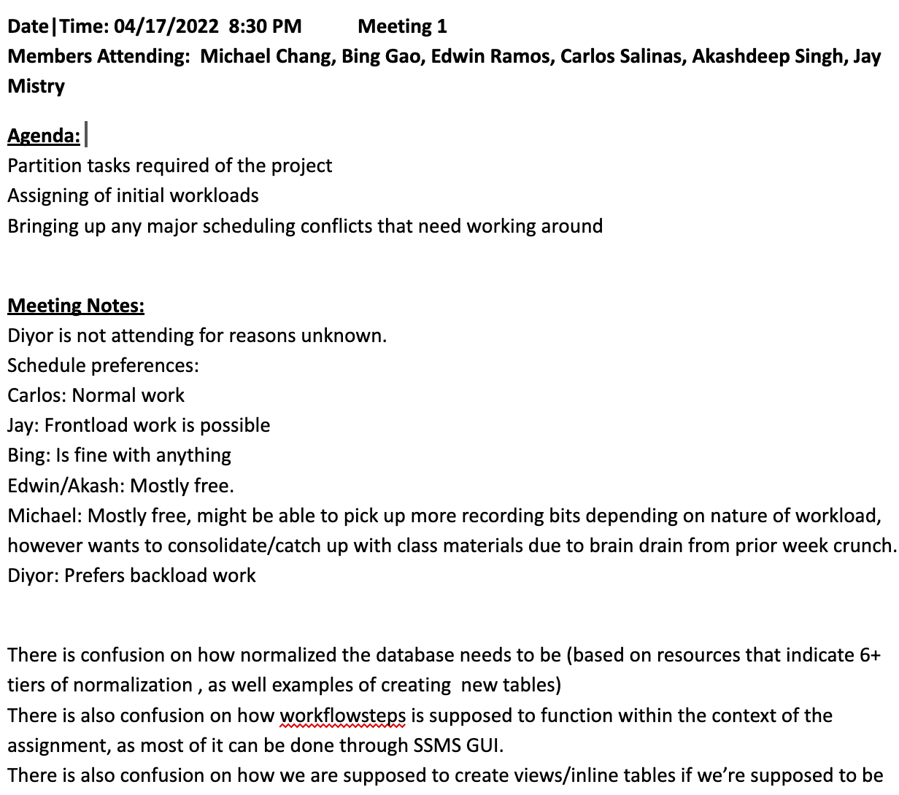
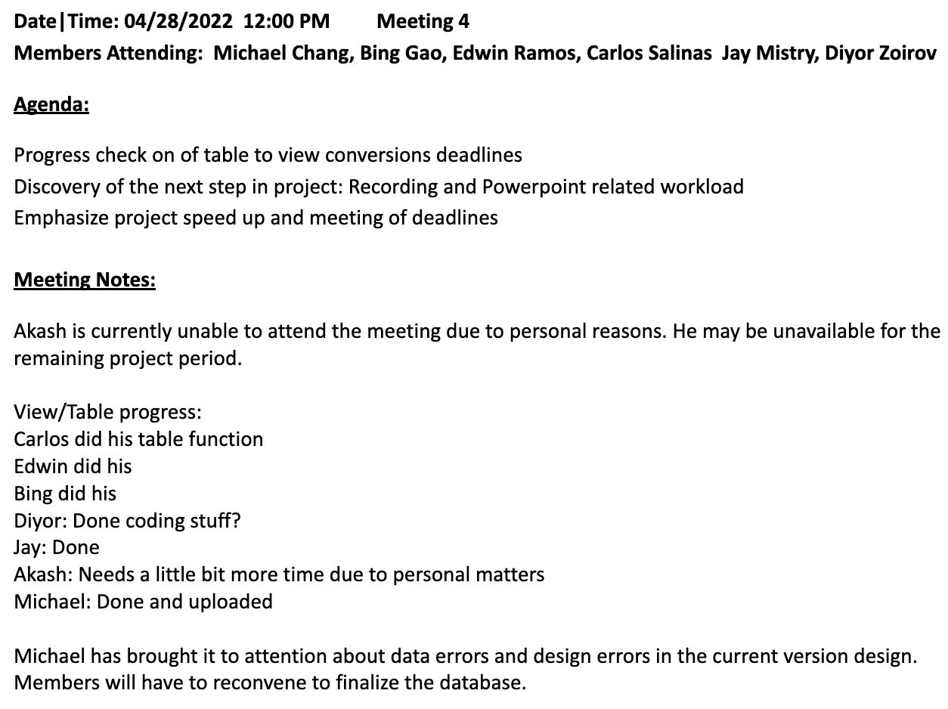
Team Agenda

Slide 3
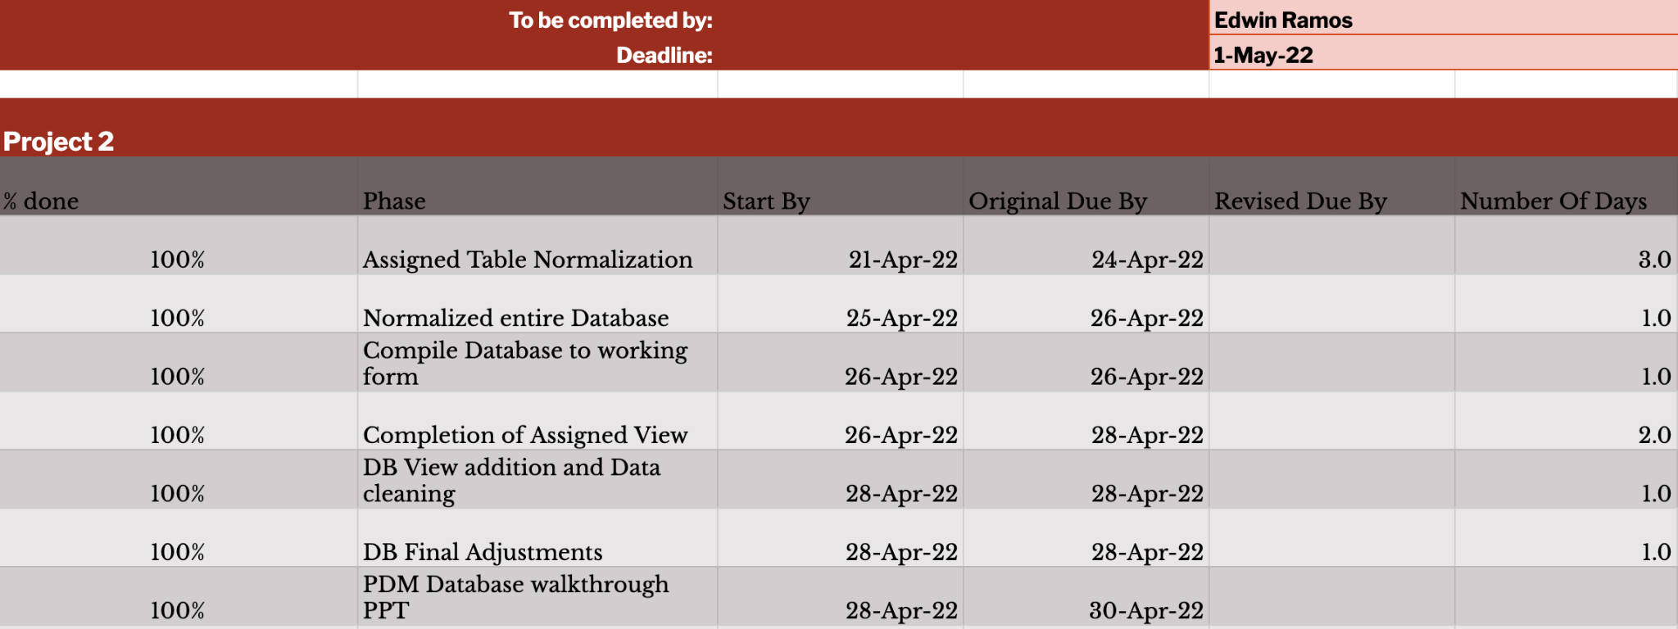
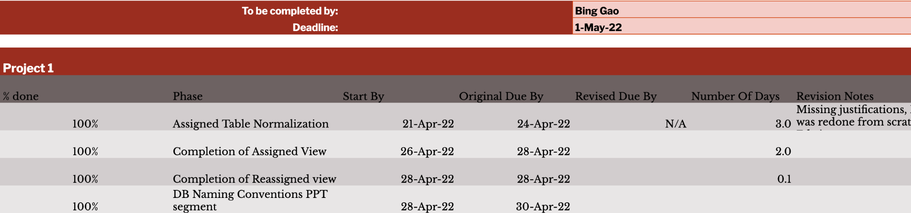
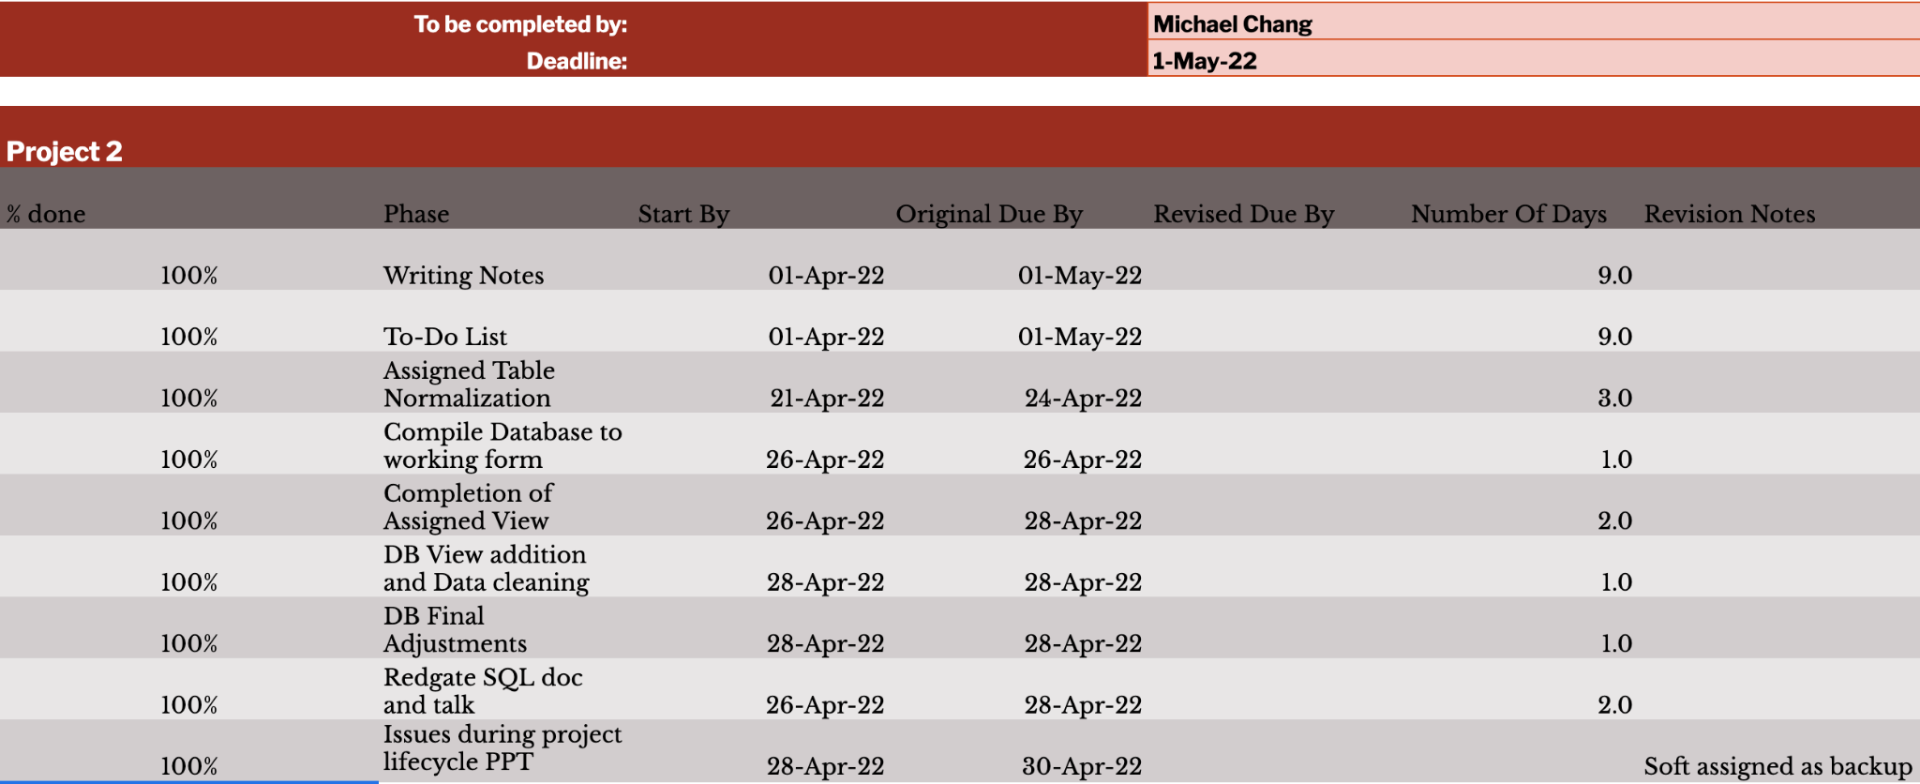
Individual To-Do’s Lists

Slide 4
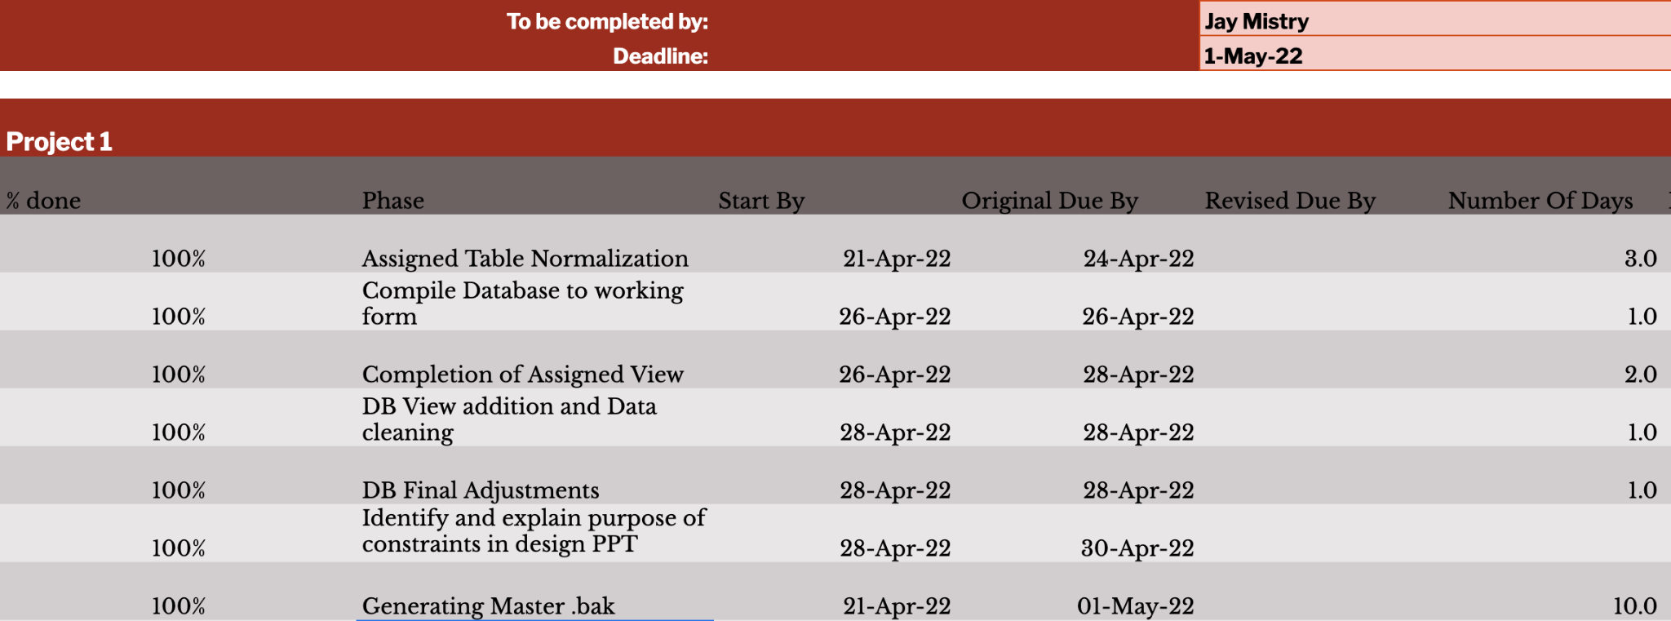
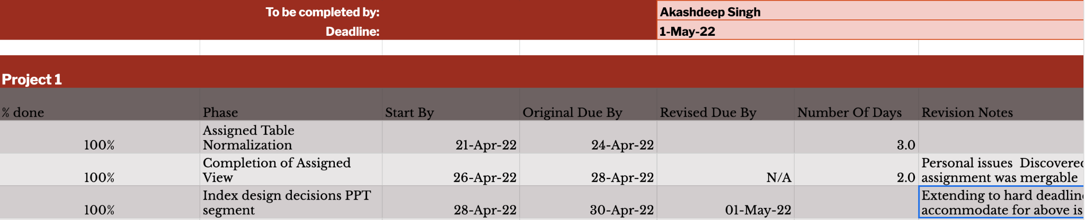
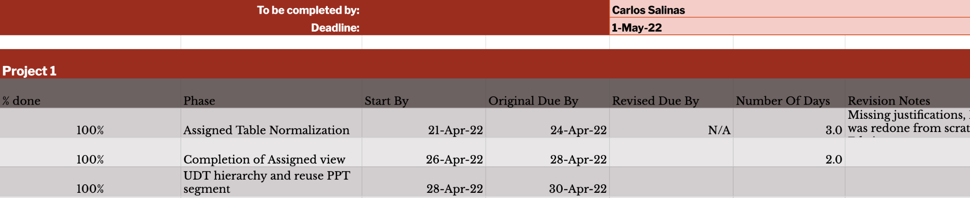
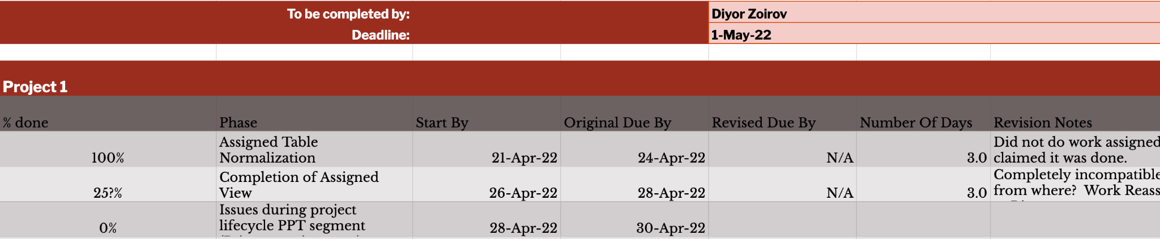
Individual To-Do’s Lists

Slide 5
Scheduling and Workflow Conflicts
Trouble starting the project over spring break due to members having vacations plans. The process had to speed up the following week to make up for it.
Encountered schedule conflicts due to members being at work, therefore some meetings had to be rescheduled.
We also had issues on how workflowsteps should function and how normalized the database needed to be.
Some of the code from the members did not work so it had to be redone and fixed in order to put everything together in one piece.

Slide 6
Secondary Tools Redgate Toolbelt
Unfortunately, the use of the full range of the Redgate Toolbelt was heavily limited.
Half the project members did not use the Windows OS ,thus could not use SSMS or Redgate.
Within the toolbelt, some of the tools were not useable for the project scope.
Other tools like SQL Compare or SQL Source Control, may have been useful with more time for familiarization
The tools with immediately noticeable and useful applications were SQL Prompt, SQL Doc and SQL Search.

Slide 7
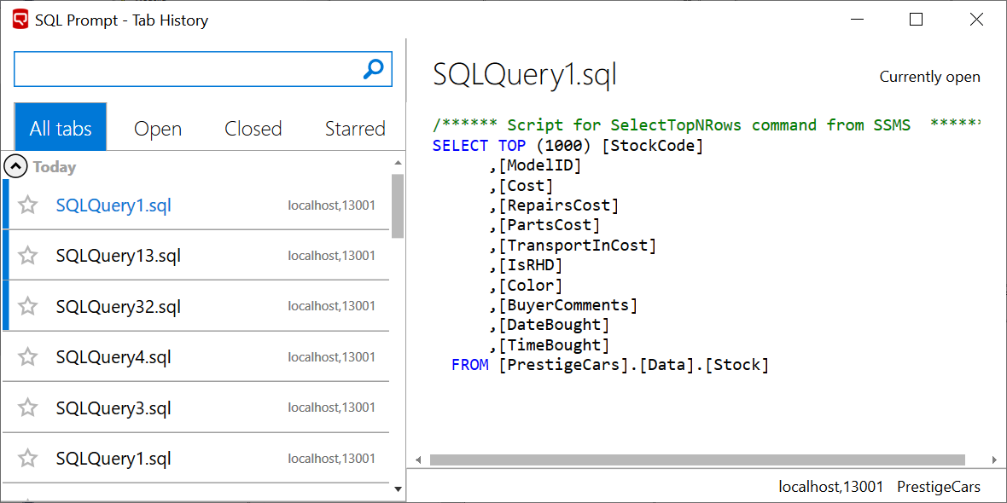

Slide 8
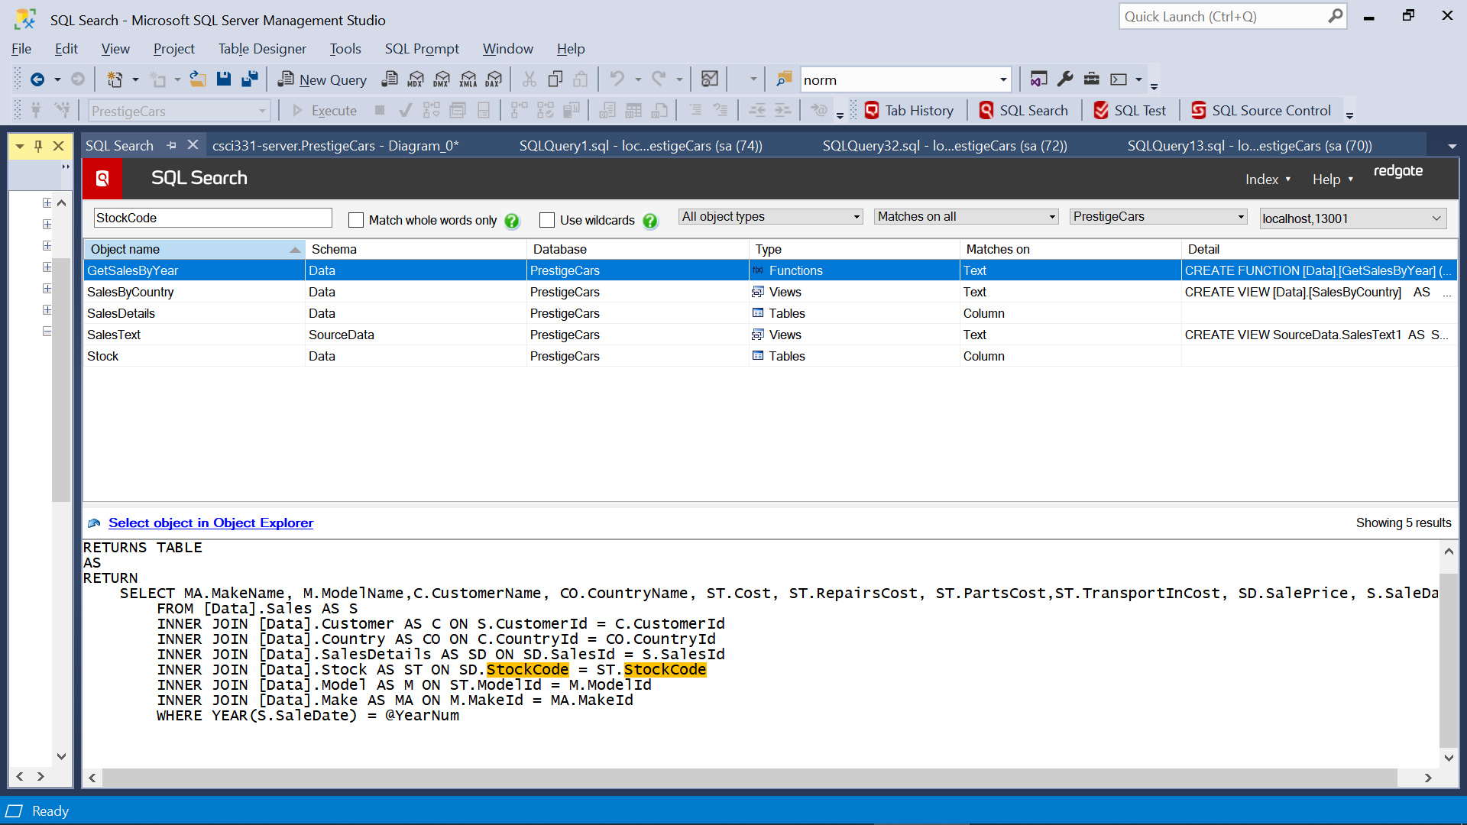

Slide 9
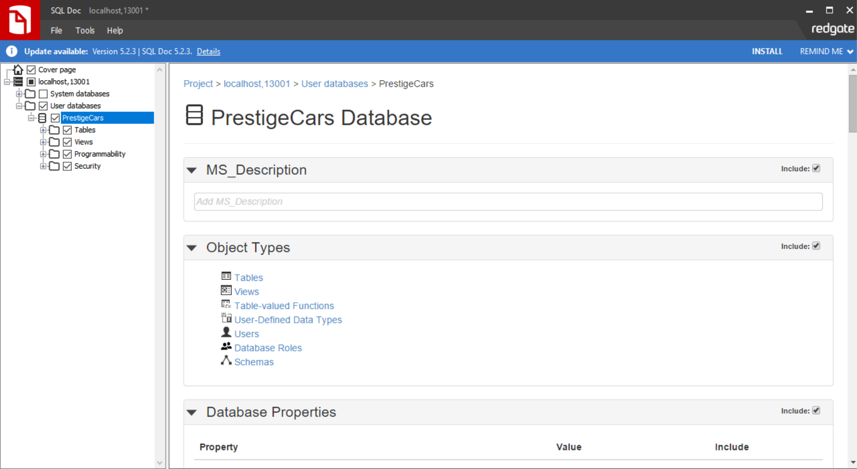

Slide 10
Data Anomalies
Data.Model had an entry that had a blank but not null column for model variant. We decided to just nullify it.
Data.Sales had a column called ID, that was a duplicate of column SalesID. We got rid of it.
Data.Country had 3 columns that weren’t being used.
Data.Sales only went to sales in 2017, but we had sales information for up to 2018 somewhere so we combined the two into one sales table.
There are no Sales.Details for any sales made in 2018 in the database.
StockCode is essentially representative of a primary key and will be treated as such, as opposed to assigning an integer only key.
StockCode is referenced as StockID in SalesDetails, this is changed in the normalization to StockCode.

Slide 11
Data Anamolies Cont..
There were only 100 valid models of cars to be found in our database, but we had some that referenced an id well above that threshold. Upon cross referencing to try to sanitize the entry and enter the appropriate correct information we discovered that the StockCode for the entry did not exist in the stock table and was therefore an invalid entry.
Department table was discussed, but we argued against doing because while it currently violates normalization the moment there is a second employee who shares a name with someone else (IE: there are two Gerald’s) the violation no longer exists.
StaffHierarchy was moved into staff, and converted from hierarchyID into a string for presentation purposes.

Slide 12
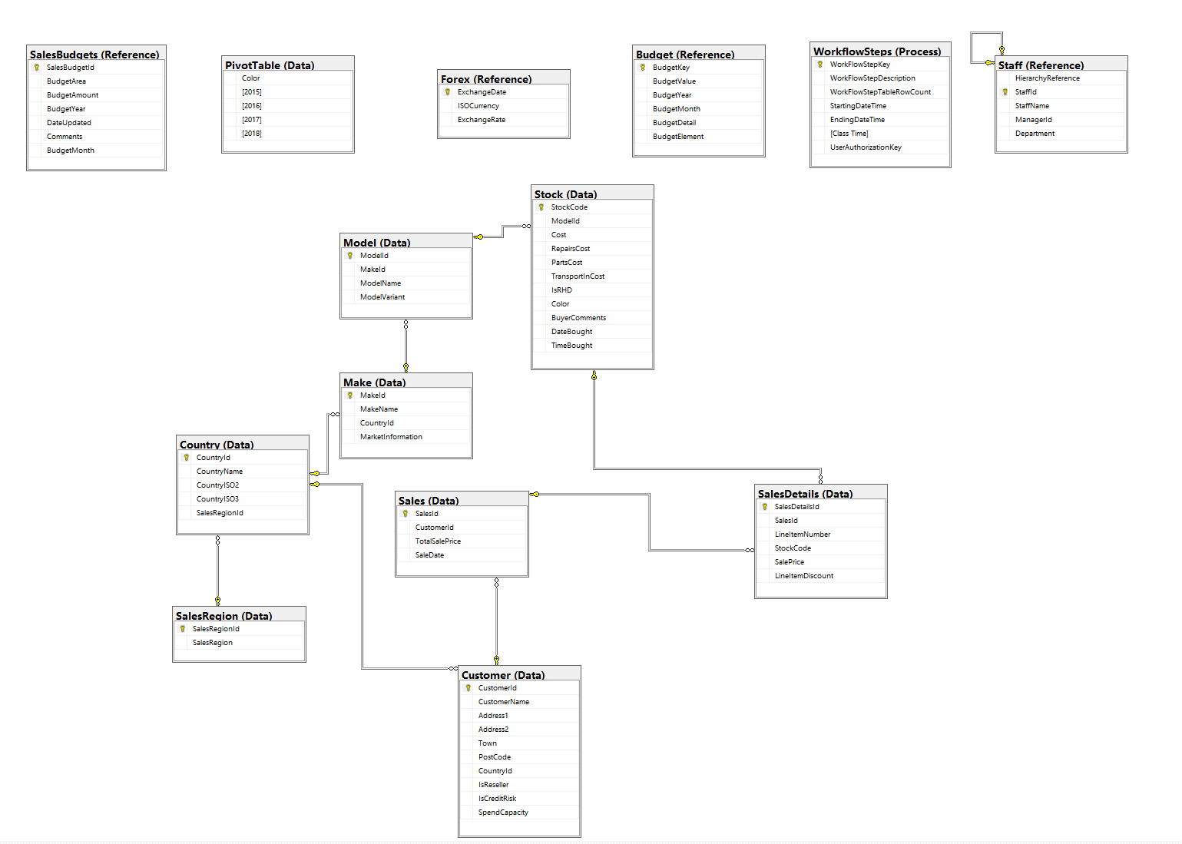
Naming Conventions for the Project
Set the rules for database
Increase the readability
Easy to manage
Pretty logical
Save time
Database structure well organized and easily readable

Slide 13
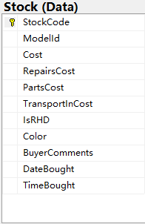
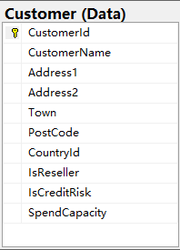
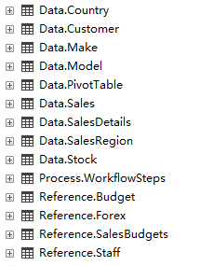
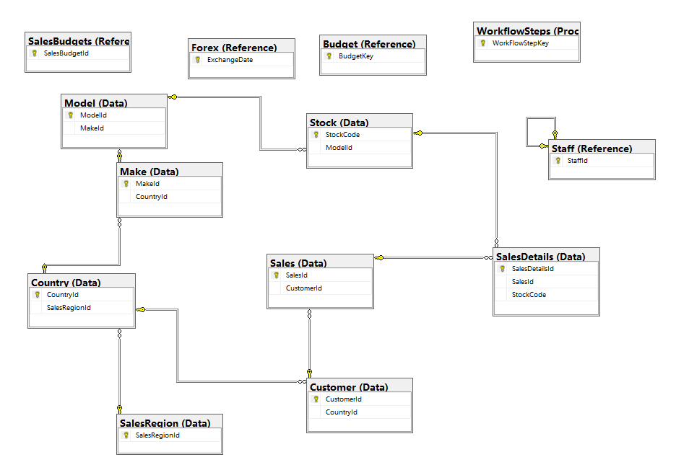
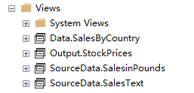
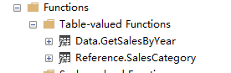
Naming Conventions for the Project (Bing G.)
Name Table: Singular and Plural Nouns
Primary and foerign keys: TableId or TableKey
Column and View
Function: ActionResult

Slide 14
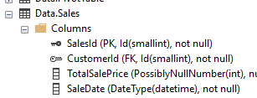
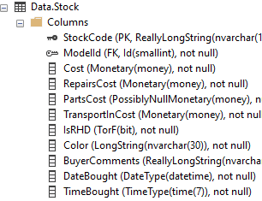
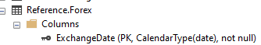
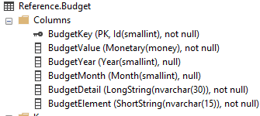
Date & Time UDTs
CalenderType
DateType
TimeType
Month
Year

Slide 15
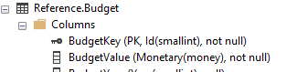
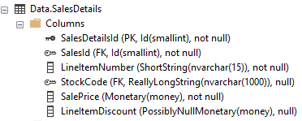
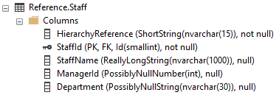
Integer & Currency UDTs
Id
NullableId
Monetary
PossiblyNullMonetary
PossiblyNullNumber

Slide 16
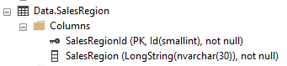
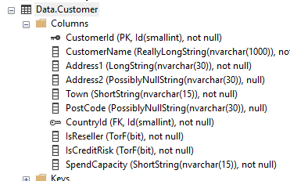
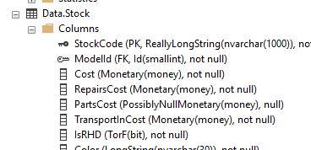
Nvarchar & Bit UDTs
LongString
PossiblyNullString
ReallyLongString
ShortString
TorF

Slide 17
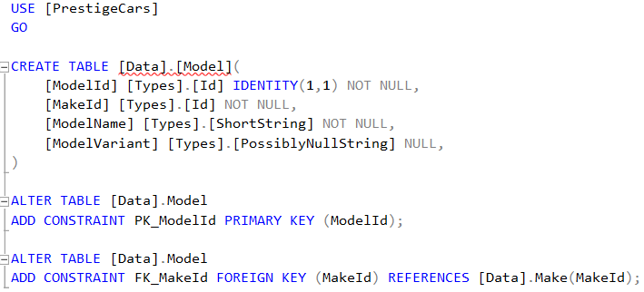
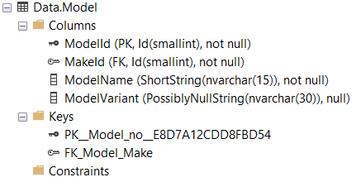
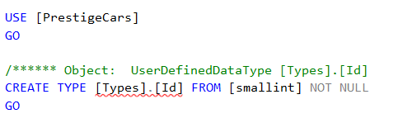
Database Constraints

Slide 18
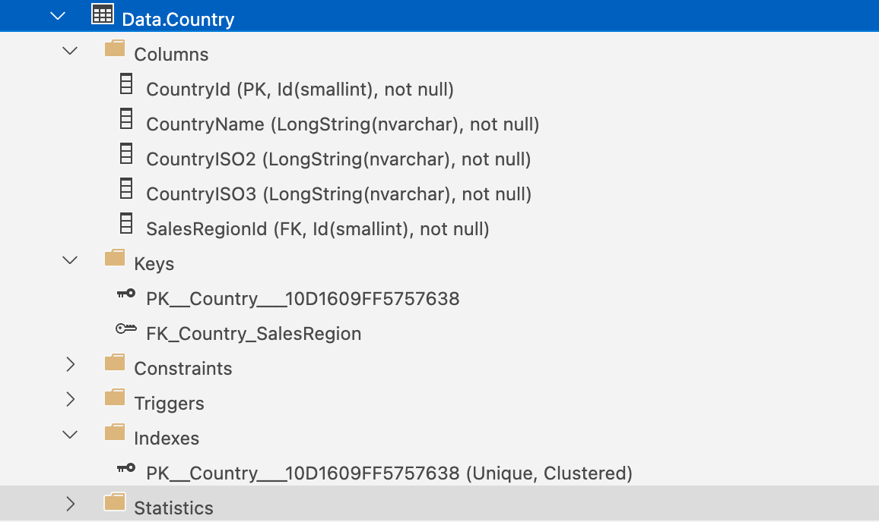
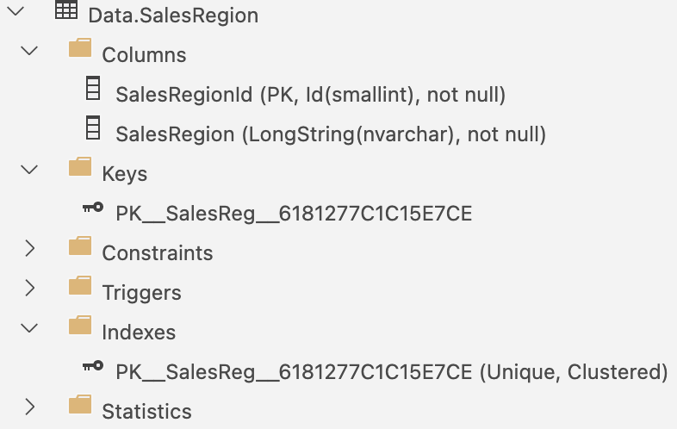
Index Designs for Data.Country
& Data.SalesRegion
Add Constraint ‘FK_Country_SalesRegion’ from Foreign Key SalesRegionId from Data.SalesRegion
Index Clustered Primary Key CountryId in ascending order is assigned after table creation
Index Clustered Primary Key SalesRegionId in ascending order is assigned after table creation

Slide 19
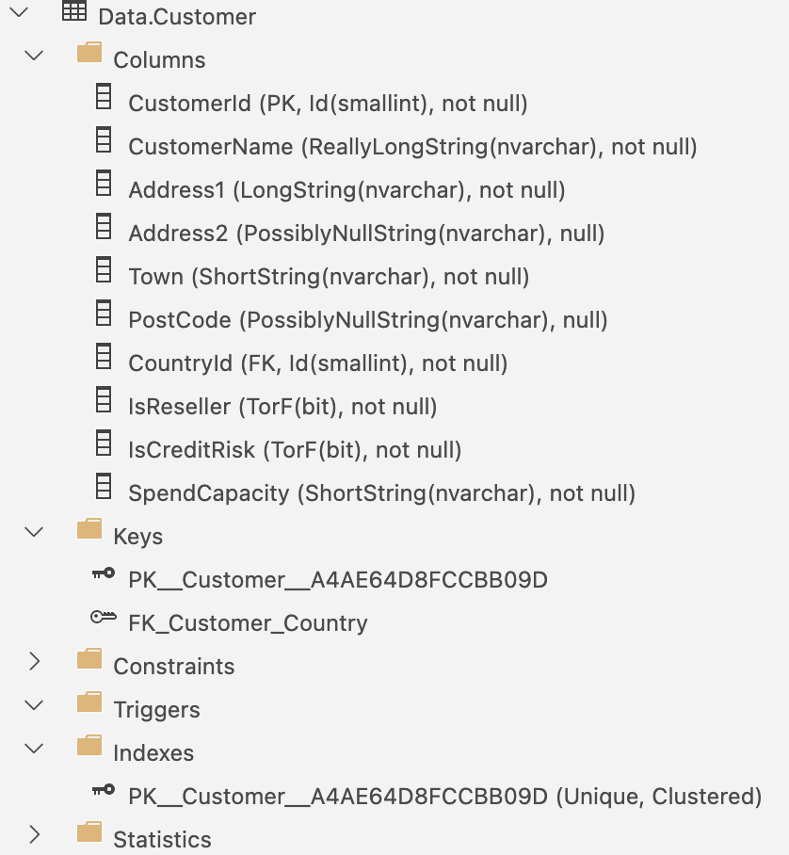
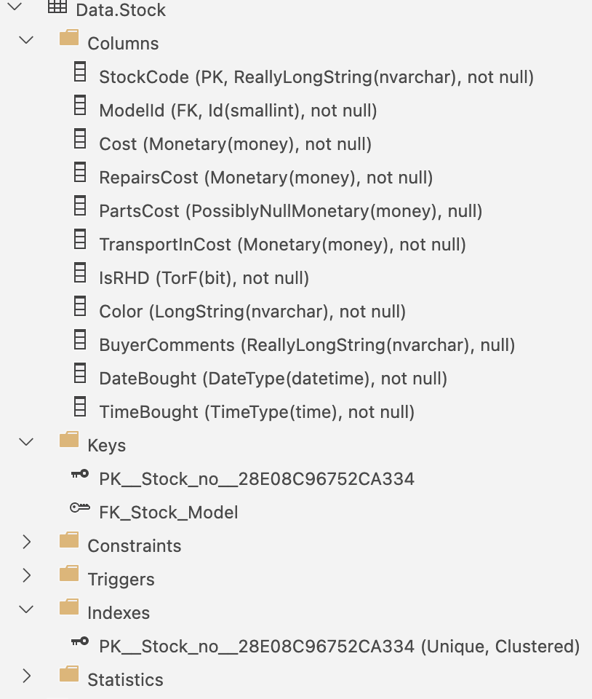
Index Designs for Data.Customer
& Data.Stock
Add Constraint ‘FK_Costumer_Country’ from Foreign Key CountryId from Data.Country
Index Clustered Primary Key CostumerId in ascending order is assigned after table creation
Add Constraint ‘FK_Stock_Model’ from Foreign Key ModelId from Data.Model
Index Clustered Primary Key StockCode in ascending order is assigned after table creation

Slide 20
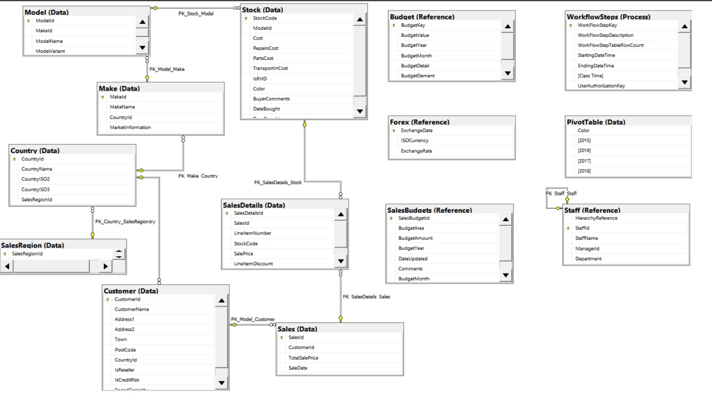
Detailed Walkthrough

